Slide 1

WEB APPLICATION ARCHITECTURE PATTERNS
WITH ANGULAR AND ASP.NET CORE
Dustin Ewers
Consultant @ Centare
Code: https://github.com/DustinEwers/angular-and-dotnet
Website: www.dustinewers.com

Slide 2



Notes:
Our story begins with a conversation
What are we here to do today?
There are so many ways to build a web application. JavaScript is everywhere and there are so many choices.
This talk is about some of the architectural choices when building an Angular App

Slide 3













Slide 4



Slide 5
Choice Overload
Choice | Options
Frontend Architecture | SPA, MVC
SPA Framework | React, Vue.js, Angular, Ember, etc…
Frontend Framework | jQuery, React, Vue.js, vanilla JS
CSS Preprocessor | SASS, LESS, plain CSS
JS build tool | Gulp, Webpack, System.js, ASP.NET Bundling
Frontend Language | ES6 (Babel), TypeScript, Flow, plain ol JavaScript
Backend Platform | Node.js, ASP.NET Core, ASP.NET full
Backend Architecture | Serverless, Monolith, Microservices
Data storage paradigm | NoSQL, SQL
Database | Mongo, SQL Server, Postgres, MySQL
Notes:
We can’t do it all, but we can focus on a few of these questions.
We’re going to look at integrating front end architecture with back end services.

Slide 6
Choice Overload
Choice | Options
Frontend Architecture | SPA, MVC
SPA Framework | React, Vue.js, Angular, Ember, etc…
Frontend Framework | jQuery, React, Vue.js, vanilla JS
CSS Preprocessor | SASS, LESS, plain CSS
JS build tool | Gulp, Webpack, System.js, ASP.NET Bundling
Frontend Language | ES6 (Babel), TypeScript, Flow, plain ol JavaScript
Backend Platform | Node.js, ASP.NET Core, ASP.NET full
Backend Architecture | Serverless, Monolith, Microservices
Data storage paradigm | NoSQL, SQL
Database | Mongo, SQL Server, Postgres, MySQL
Notes:
We can’t do it all, but we can focus on a few of these questions.
We’re going to look at integrating front end architecture with back end services.

Slide 7



Roadmap
Monolithic
Serverless
Microservice
Notes:
Going to focus on the basic architecture of Angular and how to mix it up with .NET Core.
Overview,
Then three major architectural styles
By the end, you’ll have a whole slew of ways to build a web app

Slide 8
Angular
Yet Another JavaScript Framework
Notes:
New Angular, not old Angular

Slide 9
Alternatives
React.js
Vue.js
Ember
Popular
Choice Fatigue
Sketchy Licensing
Easy to Learn
Lightweight
Choice Fatigue
Opinionated
Pokey
Longevity

Slide 10
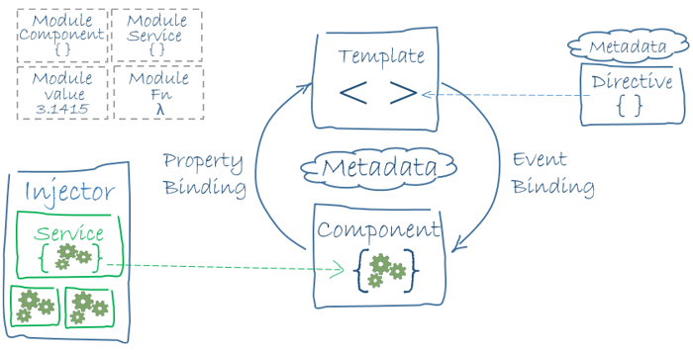
Architecture Overview
Notes:
Angular applications are a series of components and services, housed within modules.
Each component is composed of smaller components and each module is composed of smaller modules.

Slide 11
Monolith Web Apps
Sometimes the old ways are the best ways
Notes:
Photo by Dawn Armfield on Unsplash

Slide 12
User Interface
Module
Module
Module
Data Layer
Notes:
Can have lots of modules and internal structure, but it’s one app at the end of the day.
Even argue that SOA where you have a service backing an MVC app is still a monolith.

Slide 13
Why?
Everything is one place
Easy to refactor
Easy to deploy

Slide 14
Why not?
Scalability Sucks
Complexity
Tight coupling

Slide 15
Demo

Slide 16
Serverless
Servers, we don’t need no stinking servers!

Slide 17
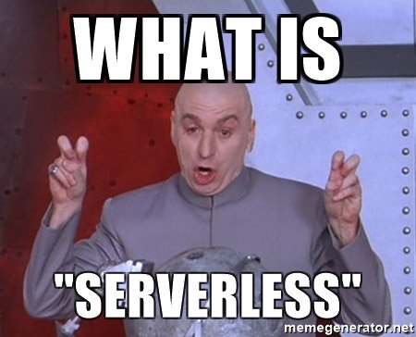
Notes:
Doesn’t mean no servers, just no servers for you to deal with.
Also reffered to as FAAS (functions as a service)

Slide 18
FAAS Providers
AWS Lambda
Google Cloud Functions
Azure Functions
Node.js
Python
Java
.NET Core
JavaScript
Node.js
C#
F#
Python
PHP
Bash
Batch
Powershell
Notes:
This isn’t it. There are lots of other frameworks, including some you can deploy yourself OpenFAAS
https://headmelted.com/serverless-showdown-4a771ca561d2

Slide 19
JAM Stack
JavaScript
APIs
Markup
API
Static Frontend
Notes:
Javascript + API + Markup
https://jamstack.org/
Statically hosted Angular files
Plus some sort of backend like Firebase or a FAAS Provider

Slide 20
Why?
Fast development cycle
Functions abstract the need to manage servers
Easy to scale

Slide 21
Why Not?
Testing
Vendor lock in
Hard to calculate pricing
Notes:
Serverless framework helps with vendor lock in

Slide 22
Microservice
Small is the new big

Slide 23
Microservice Architecture
Service
Frontend
Service
Data
Service
Notes:
It’s a single responsibility service. Applications can be composed of several different services

Slide 24
Why?
Scalable
Maintainable
Reusable

Slide 25
Why not?
Speed
Scoping is hard
More deployments

Slide 26
Scoping
Do This
Not this
Notes:
Try to keep things in vertical slices
Make it easy to rescope services, boundaries change

Slide 27
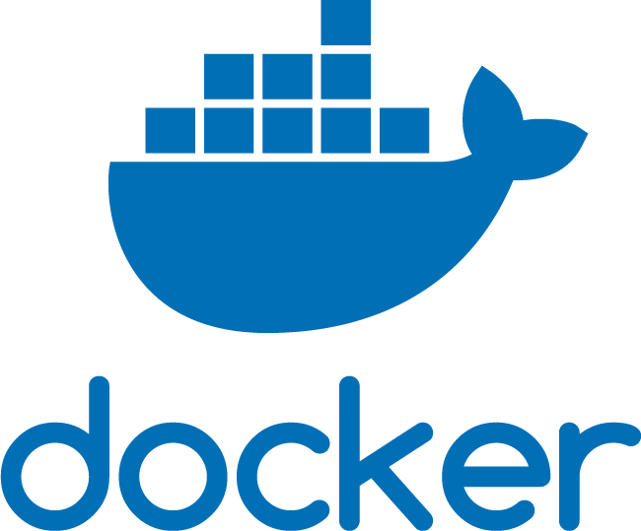
Make it Easy to Deploy
Notes:
You need to make it easy to build and deploy your services
Docker is your friend, as it provides an isolated environments and reproducible deploys
Other CI tools are okay too

Slide 28


Sharing is Caring

Slide 29
Demo

